Slide 1

DB2 Analytics Accelerator Loader for z/OS
Information Management for System z

Slide 2

Agenda
Accelerator Discussion
Accelerator Loader Details
  Group Consistent Load
  External (Dual) Load
  General Loader Details
Roadmap
ISPF Interface Examples
Next Steps / QA
Summary

Slide 3



IBM DB2 Analytics Accelerator Product Components
PureData System for Analytics
Technology
zEnterprise
CLIENT
Data Studio Foundation
DB2 Analytics Accelerator Admin Plug-in
Network
OSA-Express3/4/5
10 GbE
Primary
10Gb
Backup
Data Warehouse application
DB2 for z/OS enabled for IBM DB2 Analytics Accelerator
IBM DB2 Analytics Accelerator
Users/
Applications

Slide 4





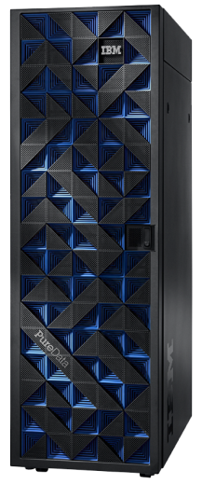
Deep DB2 Integration within zEnterprise
Applications
DBA Tools, z/OS Console, ...
Application Interfaces
(standard SQL dialects)
Operational Interfaces
(e.g. DB2 Commands)
DB2 for z/OS
Data
Manager
Buffer
Manager
IRLM
Log
Manager
IBM
DB2
Analytics
Accelerator
. . .
Consistent Load
Superior availability
reliability, security,
Workload management
Superior performance on analytic queries
z/OS on System z
PureData System for Analytics
Dual Load
DB2 Analytics Accelerator Loader
Notes:
While all other DB2 components are implemented on a common code base and operating system services (in DB2 case that‘s z/OS), the DB2 Analytics Accelerator is an out-board component. By the nature of its workload, it requires massive parallelization and hardware aceleration, that in terms of price/performance cannot be realistically implemented on System z..Namely, DB2 Analytics Accelerator is a single workload server, while System z main strength is its legendary capability to handle many and mixed workloads. So, it does not make sense to take System z and make out of it a single purpose system.
Consequently, we decided to host that new DB2 component on a platform that offers abundance of resources and at the same time does not need all the System z quality of service characteristics.. DB2 Analytics Accelerator is implemented, packaged and installed as an appliance, with no interactions with the operational staff, no tuning, no direct log-on access in everyday operations
So, addition the DB2 Analytics Accelerator creates a hybrid platform which is very much on the strategic path of future enterprise systems. The key take away from here is that the non-z elements of the hybrid are transparent to the outside world.
One could also draw a parallel with specialty processors we have already introduced in the z architecture: zIIP and zAAP which goal is to offload cycles of selected workloads from the general purpose CPUs, but the similarity stops there: these offload processors are completely different architecture, they are off-board and the main reason to use them is their abundance at price/performance competitive rate.
Moving to the next chart ...

Slide 5

DB2 Analytics Accelerator Customer Usage
How many customers currently have an accelerator?
  How many accelerators?
  What Version are you running 3.1? 4.1?
  How are they used today?
    Accelerate production/OLTP queries?
    Operational Data Store (ODS)
    Building data warehouse?
  Pain points?
  Future accelerator projects?
Customers who are interested in an accelerator?
  How are you intending on using/exploiting?
    Accelerate production/OLTP queries?
    Operational Data Store (ODS)
    Building data warehouse?
  How many accelerators are you planning for?

Slide 6

DB2 Analytics Accelerator Loader: Group Consistent Load
What is Group Consistent Load?
  Loads groups (or sets) of operational DB2 tables to the accelerator at a user-specified time. One time specified for all tables.
  Transaction Consistent: Uncommitted transactions at the specified time are not loaded to accelerator
    Ex: Update Parent Table, Update Child Table, Commit
    If Load is run after parent update but before child update, the update to parent table will not be loaded to accelerator
  No tables locked during consistent load process!
  Usability feature not a performance feature

Slide 7
DB2 Analytics Accelerator Loader: Group Consistent Load
Loading data to Accelerator from Operational DB2 Tables
  Possible pain points with existing load process:
    Loading related tables requires taking DB2 tables offline for update
    No method to load historical copy of tables into Accelerator
  DB2 Accelerator Loader business value:
    Maintain availability of related tables during the load process
    Load or refresh accelerator with zero impact to business critical data
    Ability to load to accelerator with historical data
    Improved availability and flexibility!

Slide 8


Current Process to Load Accelerator
Production DB2 Tables
DB2 Analytics Accelerator
Table A
Load Process
Table B
Table C
Unloads Run Against Production Tables
Production Tables May Be Locked During Load
Notes:
Using the standard accelerator load process, related tables are locked (no updates allowed) during the load process to get a consistent copy of the tables into the accelerator.

Slide 9
IBM DB2 Analytics Accelerator Loader
Group Consistent Load
Backups
& DB2 Logs
DB2 Analytics Accelerator
Table A
Copy
Load Process
Table B
Copy
DB2 Logs
+
Table C
Copy
Midnight
Noon
Midnight
Accelerator Loader loads from Image Copies and Logs
No Affect to Production Tables!
The Accelerator Loader provides an option to load a consistent set of data to a historical point-in-time into IDAA.
6:00am
6:00pm
Notes:
The IBM DB2 Analytics Accelerator Loader can load the accelerator using backups (image copies) and the DB2 recovery logs. There is no outage of the production application during the load process.

Slide 10
Group Consistent Load: Internal Details
Users specify point in time to load
Loader selects appropriate image copies before point in time
  Supports full image copies
  Incremental image copies
  Inline image copies
  FlashCopy image copies
Reads log records from image copy point to specified PIT
Sorts log records in Page/Time sequence
Reads and merges image copies
Applies sorted log records to page
Extracts table rows from page
  Decompresses rows
Writes table rows to accelerator

Slide 11
Group Consistent Load: FlashCopy Option
Loader can optionally create a new FlashCopy Image Copy
  Only valid when loading accelerator to current PIT
  Loader creates new FlashCopy Consistent Image Copy
  Extracts data from FlashCopy Image Copy
  Log Read / Apply Process still executed
Exploits fast replication technology
  CPU and I/O for FlashCopy executed in storage processor
  Very fast process – Almost instantaneous
  Not required
Consider using FlashCopy option
  If last image copy was taken several days or more ago
  Eliminates log reading - Faster and lower cost option

Slide 12
Group Consistent Load: Considerations
Direct load from image copies/logs from other DB2 systems not currently supported
  OLTP → IDAA
  Targeting second half of 2014
Currently does not integrate with CDC
  Known requirement for future support
  Targeting second half of 2014
  Will allow loading replicated tables without locking
Table alters currently require a post DB2 Reorg
  Table definition is altered, a reorg is required before running consistent load
No support today for multi-table tablespaces
  Most tablespaces are single table
  Can be added if market demands support

Slide 13
Group Consistent Load Benefits
Historical data can be reset on the accelerator
  Benefit: Easily reset data to a historical point in time.
  Value: Reduce CPU consumption and elapsed time resetting data!
Related sets of tables can be loaded into the accelerator to a consistent point in time
  Benefit: Leverage FLASHCOPY technology when loading consistent sets of data to the accelerator.
  Value: Eliminate application downtime!

Slide 14

Building Data Warehouse on DB2 z/OS
External Data
DB2 Tables
DB2 Analytics Accelerator
File A
Table A
#1
#2
File B
Load
Table B
Load
File C
Table C
Two Step Load Process – Elongated Load Cycle - CPU Resource Intensive

Slide 15
DB2 Analytics Accelerator Loader: External Load (Dual Load)
User Extracted
External Data
DB2 Tables
DB2 Analytics Accelerator
File A
#1
File B
#1
Load
Load
Table A
File C
Table B
Table C
Parallel Load into DB2 and Accelerator! – Faster Load Cycles! – Reduce Costs!

Slide 16
DB2 Analytics Accelerator Loader: External Load (IDAA Only)
User Extracted
External Data
DB2 Tables
DB2 Analytics Accelerator
File A
R
E
D
U
C
E
D
S
T
O
R
A
G
E
#1
File B
#1
Load
Load
Table A
Table A
File C
Table B
Table B
Table C
Table C
IDAA Only Load – Reduced Elapsed Time – Reduced Cost – Reduced DASD

Slide 17
IBM DB2 Analytics Accelerator Loader
External Load (Dual Load)
Loading data external from DB2 into Accelerator
  Pain Points
    Data must first be loaded into DB2, then from DB2 into Accelerator
    Loading data into DB2 can be CPU intensive
    No way to load data directly to Accelerator
  DB2 Accelerator Loader Business Value
    Improved and simplified process - one step instead of two
    Exploits zIIP processor to reduce cost of loading to Accelerator
    Provides significant CPU and DASD savings on the source (DB2)
    Provides TCO savings with CPU and Elapsed Time improvements
    Provides path to load accelerator directly from external file

Slide 18
External Load Details
Accelerator Loader can load data from a file in one of two methods:
  Dual External Load: Loads data into both DB2 and the Accelerator in parallel
  Accelerator only: Accelerator Loader loads directly into Accelerator (no load in DB2)
User is responsible for building the load file
  Extracted data can come from VSAM, IMS, Oracle, etc.
  File must be compatible for input into the DB2 LOAD utility
  Field specification must describe input data format. This must be compatible with the DB2 LOAD utility.

Slide 19
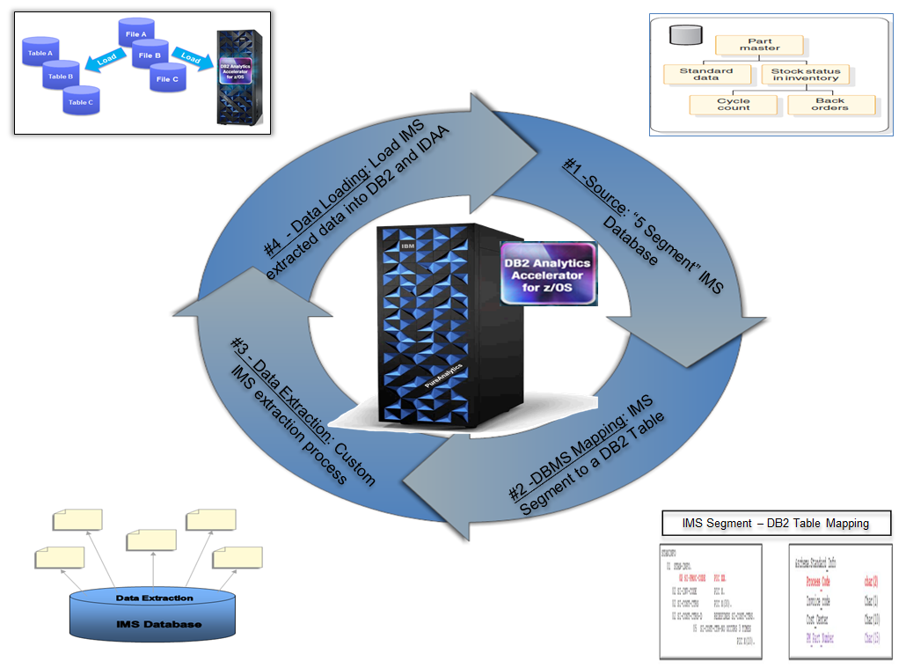
IMS to IDAA – External Load Process

Slide 20
Partition Parallelism
Enabled with APAR PI11753
  Dual & Consistent Load
  DB2 pre-req APARs – PI10162/PI09425
  1 input SYSREC per partition
Max Parallelism
  IDAA Parameter
    AQT_MAX_UNLOAD_IN_PARALLEL
    &hilevel.SAQTSAMP(AQTENV)
  Accelerator Loader Parameter
    ACCEL_LOAD_TASKS
    Acceptable values 0-20
    Should be set to equal or less than AQT_MAX_UNLOAD_IN_PARALLEL
Performance Estimates
  DB2 LOAD utility & Native IDAA Load compared to Accelerator Loader - External Load
  Up to 55% reduction in elapsed time
  Up to 35% reduction in CPU
  Mileage may vary

Slide 21
Additional Performance Considerations
Data Conversion
  External to Internal Data conversion is zIIP enabled
  Faster DB2 load utility (DSNUTILB) due to Internal Data
Dual Load – “Double Load”
  DB2 and IDAA Loaded in Parallel
  Input SYSREC is read once
External IDAA Load
  Loads only IDAA
  Up to 60% general purpose CPU reduction
  DB2 DASD Savings
  Mileage may vary

Slide 22
External Load Details - Considerations
NULLIF/DEFAULTIF Syntax
  Supported with APAR PI13308 – April/May 2014
  Usually a concern for consolidating DB2 tables into warehouse
  Pre PTF PI13308 will cause a syntax error in the loader
Tables in replication mode not currently supported
  Not usually a concern for loading data from external files
  Support targeted for second half 2014
Field Specification Required
  Must be included in External Load Syntax
  Can be generated by many tools
  Looking at adding support no field specification
  Support coming soon

Slide 23
External Load: Internal Details
Users submit DB2 Load JCL with additional directive
  Add IDAA_DUAL ON accelname
  Or IDAA_ONLY ON accelname
  Add //HLODUMMY DD *
Loader Intercepts DB2 Load Utility
  Sees additional syntax (above)
Loader reads SYSREC (input file)
  Converts data to DB2 Internal Format (Under zIIP)
  Changes DB2 Load to ‘Internal Format’ (runs faster)
Loader sends internal format data to Accelerator and DB2 Load Utility or Accelerator Only

Slide 24
Profiles – Dual Load JCL
Have IBM DB2 Load JCL (DSNUTILB) Already?
  Easiest way is to add HLODUMMY DD DUMMY
  Add IDAA_DUAL ON accelname
  Or IDAA_ONLY ON accelname
  No other changes necessary
  NULLIF and DEFAULTIF syntax not honored
    Ignored on Accelerator only load
    Fails on a DUAL load
    Support is being added. Target 2Q 2014

Slide 25
External Load Accelerator-Only Considerations
When should user consider loading accelerator only?
  Data is maintained and updated elsewhere
  DB2 is not required for data backup and recovery
  Data Validations
    Load Utility is not run - No RI or Constraint Checking
  All queries are qualified for accelerations
    No unsupported data types such as LOB or XML
    If DB2 executes query locally
      Initial Updates – Fail/SQL Code 100
        0 rows in DB2 table after load
      Inserts – Will execute
      Initial Deletes – Fail/SQL Code 100
        0 rows in DB2 table after load

Slide 26
External Load ‘Accelerator-Only’ Considerations
Table must still exist in DB2 Catalog
  Will be emptied upon load
Users should define small tablespaces
  Prevent large datasets sitting unused
Access to accelerated table remains via DB2
  All DB2 security is honored
DB2 Optimizer must send queries to accelerator
  Any query accessing DB2 table will have inconsistent results
User Beware: Minor application change required
  Special register directs all queries to Accelerator
  SET CURRENT QUERY ACCELERATION = ALL
  Can be set in JDBC/ODBC connections
  Future change coming in DB2 for Accelerator Only tables

Slide 27
External Load Value and Benefits
  Benefit: Eliminate the hassle of creating a program to invoke the stored procedures
  Value: Reduce labor when loading into DB2 and the Accelerator!
  Benefit: Reduces CPU and I/O over standard process
  Value: Saves valuable z/OS resource and $$$
  Benefit: Use the DB2 LOAD utility to load into both places!
  Value: Simplify DBA tasks by using a familiar utility! Reduces time to perform load

Slide 28
Accelerator-Only Load Value and Benefits
  Benefit: Data does not have to exist in DB2 tables
  Value: Save DASD resources, CPU consumption and processing time loading only into the accelerator!
  Benefit: File data can be loaded in a more automated manner directly into the accelerator
  Value: Reduce DBA labor loading data with the accelerator Loader without first having to load the DB2 table!

Slide 29
Group Consistent or Dual Load?
Group Consistent Load
  Run when data is already in DB2
  When loading multiple related groups of tables
  When customers require related data to be consistent
External ‘Dual’ Load
  When data is in a file
  Users desire to load file into DB2, Accelerator, or both
  Can be extracted from DB2 or other sources as input to the Loader

Slide 30
Accelerator Loader: General Details
Table(s) Need to be Added/Enabled for Acceleration
Uses standard Accelerator stored procedures
  Ensures compatibility with Accelerator functions
  Accelerator GUI Client shows data as loaded
  Admin Tool shows when data was last refreshed
Validates DB2 and Accelerator tables
  Ensures that there is consistency between DB2 and the Accelerator table definitions
z/OS started task required for Accelerator Loader
  Must be running for both Group Consistent and External Load
  Handles communication with Accelerator
  Intercepts DSNUTILB execution for External Load function

Slide 31
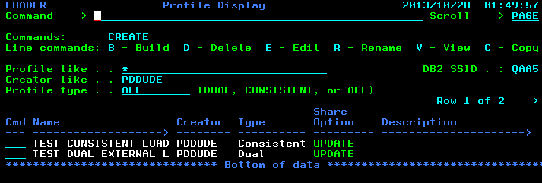
Loader Profiles
Profiles are collections of Loader options and DB2 tables to load
Can be used to build JCL to run Loader functions
Can be for either ‘Consistent’ or ‘Dual’ load functions

Slide 32
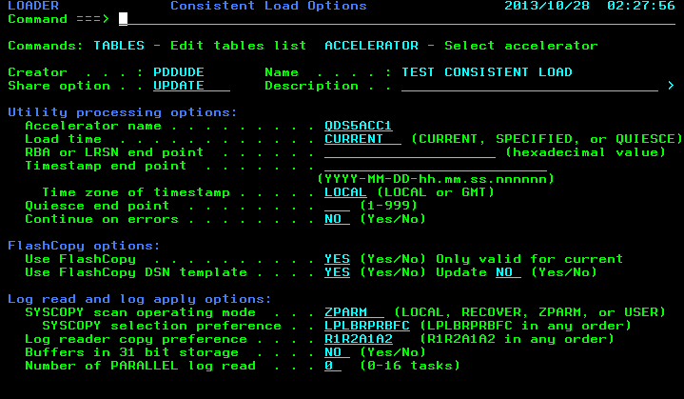
Consistent Load Options
Choose Load Time
Optional FlashCopy Options
Log Read / Apply Options

Slide 33
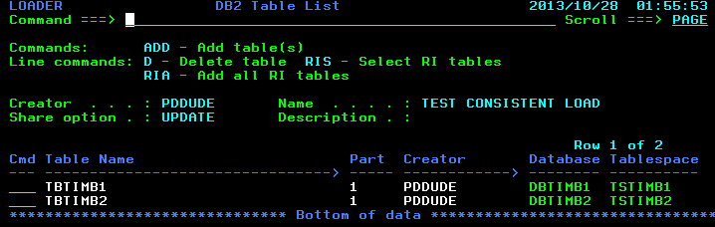
Profiles – Consistent Load Select Tables
Specify all the tables to be loader to consistent point in time
Masking is supported to select tables
Automatically add RI-related tables

Slide 34
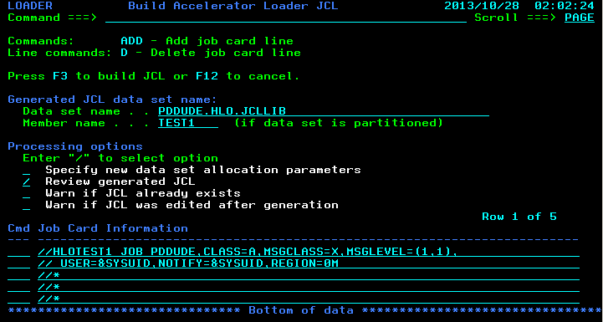
Profiles – Consistent Load Build JCL
Build JCL into a PDS or dataset name

Slide 35
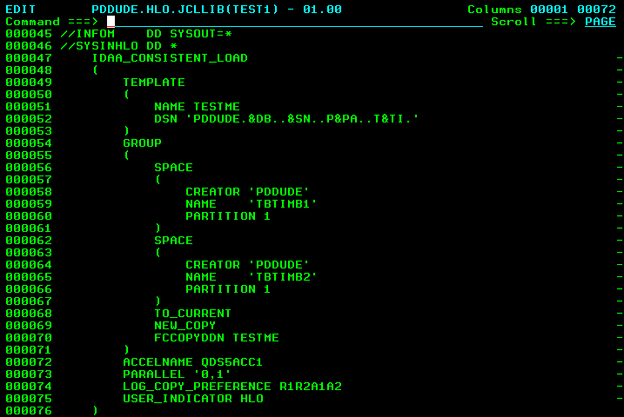
Profiles – Consistent Load JCL Example

Slide 36
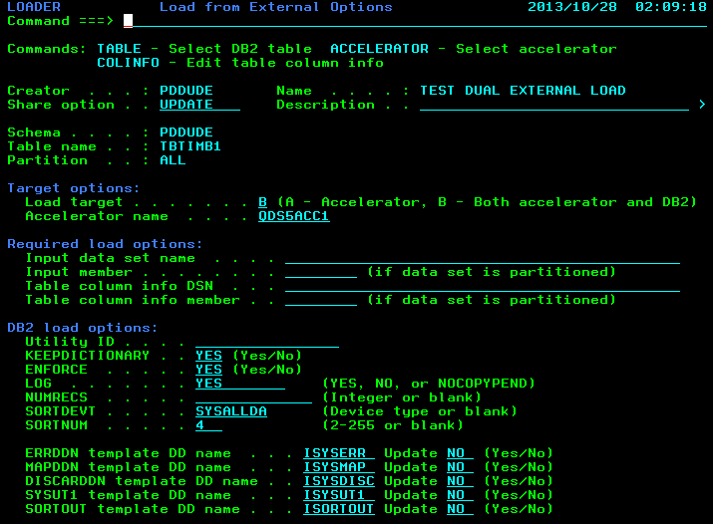
Profiles – Dual Load Options

Slide 37
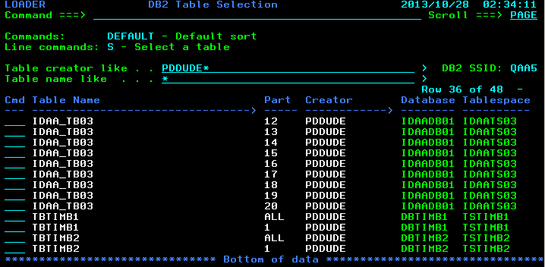
Profiles – Dual Load Table Selection
Only one table can be selected for Dual Load function

Slide 38
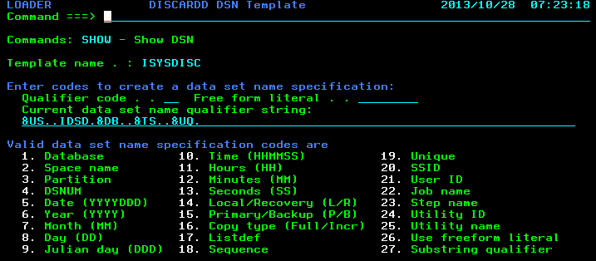
Profiles – Template DSN Builder
ISPF interface helps builds dataset names for templates
For FlashCopy and DB2 Load templates

Slide 39
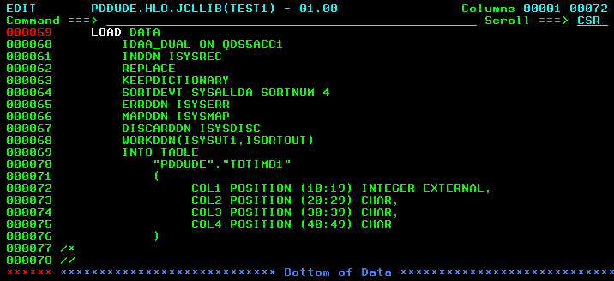
Profiles – Dual Load JCL Example
IDAA_DUAL directive tells Loader to load both DB2 and Accelerator
IDAA_ONLY directive tells Loader to load only Accelerator
  NOTE! DB2 table data will be deleted on a Accelerator-only run

Slide 40
DB2 Accelerator Analytics Loader for z/OS
Requirements:
Hardware: IBM System z196 or later
Software:
  Current maintenance for IBM DB2 Accelerator Loader
  IBM DB2 Analytics Accelerator V3.01 with PTF3 or higher
  IBM z/OS V01.12.00 or higher
  ISPF V4
  IBM SMP/E for z/OS V03.05.00
  DB2 Utilities Suite for z/OS V10.01.00
  DB2 V10.01.00 or higher
    THREE PTFs required: fix issues with DB2 trace modules
      PM95731, PM95478, PM97729
    Two DB2 APARs needed as pre--req’s for Partition Parallelism
      PI10162, PI09425
  IBM Tools Base for z/OS V01.02.00
  IBM DB2 Common Code for z/OS (FEC) V1R3
TSO/E environment requirement: Minimum region size 30000
40

Slide 41
Summary
DB2 Analytics Accelerator Loader
  Improves business availability
  Helps facilitate greater Accelerator usage
  Reduces cost of loading data into Accelerator
    Reduces CPU by exploiting zIIP
    Loads to the Accelerator and DB2 in parallel
    Reduces DASD requirements
  Simplifies the process of loading data to the Accelerator

Slide 42
Questions
?
Notes:
4/9/2014 1:16 PM
42

Slide 43

Notes:
Information Management for System z
2013 WW Tech Sales Boot Camp - Jan 28th to Feb 1st
43

